Slide 1
Chemical Bonding and VSEPR

Slide 2
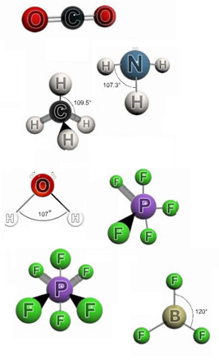
The Shapes of Molecules
The shape of a molecule has an important bearing on its reactivity and behavior.
The shape of a molecule depends a number of factors. These include:
Atoms forming the bonds
Bond distance
Bond angles

Slide 3
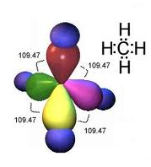
Valence Shell Electron Pair Repulsion
Valence Shell Electron Pair Repulsion (VSEPR) theory can be used to predict the geometric shapes of molecules.
VSEPR is revolves around the principle that electrons repel each other.
One can predict the shape of a molecule by finding a pattern where electron pairs are as far from each other as possible.

Slide 4
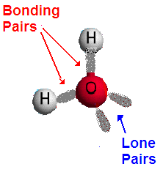
Bonding Electrons and Lone Pairs
In a molecule some of the valence electrons are shared between atoms to form covalent bonds. These are called bonding electrons.
Other valence electrons may not be shared with other atoms. These are called non-bonding electrons or they are often referred to as lone pairs.

Slide 5
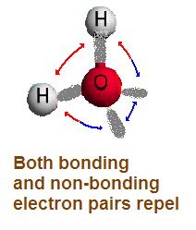
VSEPR
In all covalent molecules electrons will tend to stay as far away from each other as possible
The shape of a molecule therefore depends on:
  the number of regions of electron density it has on its central atom,
  whether these are bonding or non-bonding electrons.

Slide 6
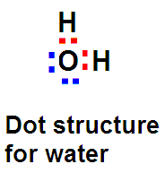
Lewis Dot Structures
Lewis Dot structures are used to represent the valence electrons of atoms in covalent molecules
Dots are used to represent only the valence electrons.
Dots are written between symbols to represent bonding electrons

Slide 7
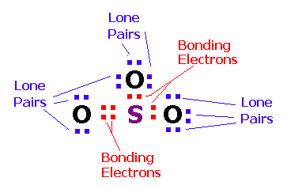
Lewis Dot Stucture for SO₃
The diagram below shows the dot structure for sulfur trioxide. The bonding electrons are in shown in red and lone pairs are shown in blue.

Slide 8
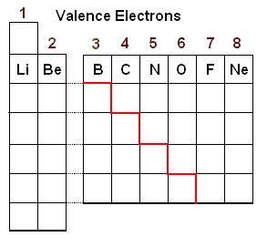
Writing Dot Structures
Writing Dot structures is a process:
Determine the number of valence electrons each atom contributes to the structure
The number of valence electrons can usually be determined by the column in which the atom resides in the periodic table

Slide 9
Writing Dot Structures
Add up the total number of valence electrons
Adjust for charge if it is a poly atomic ion
  Add electrons for negative charges
  Reduce electrons for positive charges
Example SO₃²⁻
1 S = 6 e
3 0 = 6x3 = 18 e
(2-) charge = 2 e
---------
        Total = 26 e

Slide 10
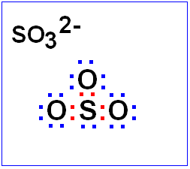
Electron Dot Structures
Make the atom that is fewest in number the central atom.
Distribute the electrons so that all atoms have 8 electrons.
Use double or triple pairs if you are short of electrons
If you have extra electrons put them on the central atom

Slide 11
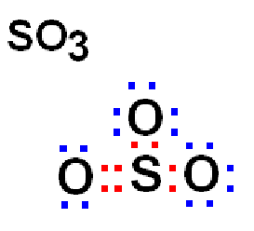
Electron Dot Structures
Example 2: SO₃
1 S = 6 e
3 O = 6x3 = 18 e
no charge = 0 e
---------
        Total = 24 e
Note: a double bond is necessary to give all atoms 8 electrons

Slide 12
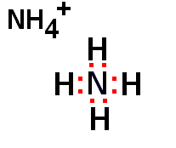
Electron Dot Structures
Example 3: NH₄⁺
1 N = 5 e-
4 H = 4x1 = 4 e-
(+) charge = -1 e-
---------
        Total = 8 e-
Note: Hydrogen atoms only need 2 e- rather than 8 e-

Slide 13
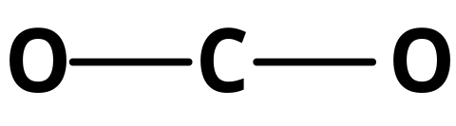
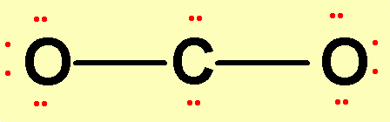
Example: Carbon Dioxide
1. Central atom =
2. Valence electrons =
3. Form bonds.
C 4 e⁻
O 6 e⁻ x 2 O’s = 12 e⁻
Total: 16 valence electrons
This leaves 12 electrons (6 pairs).
4. Place lone pairs on outer atoms.
Check to see that all atoms have 8 electrons around it
except for H, which can have 2.

Slide 14
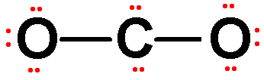
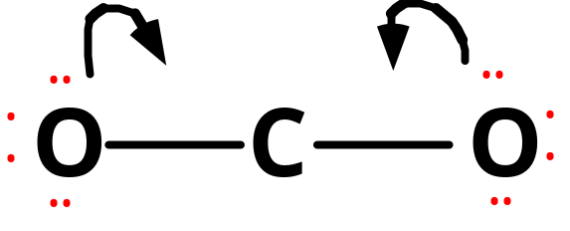
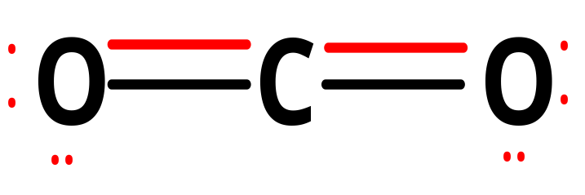
Carbon Dioxide, CO₂
C 4 e-
O 6 e- X 2 O’s = 12 e-
Total: 16 valence electrons
How many are in the drawing?
There are too many electrons in our drawing. We must form DOUBLE BONDS between C and O. Instead of sharing only 1 pair, a double bond shares 2 pairs. So one pair is taken away from each oxygen atom and replaced with another bond.

Slide 15
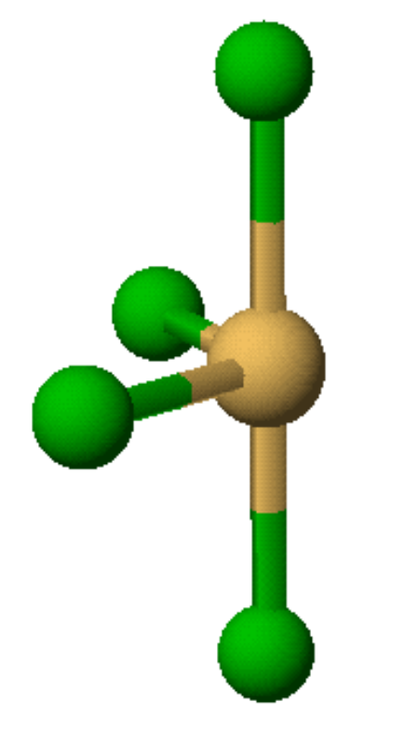
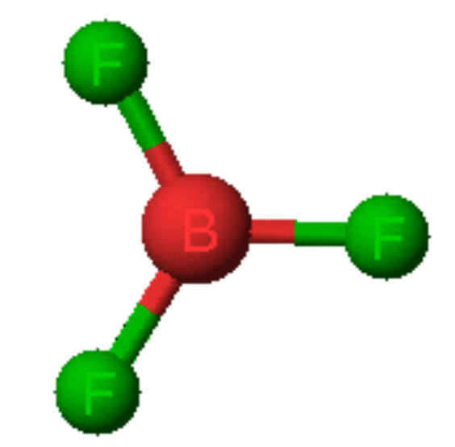
Violations of the Octet Rule
Violations of the octet rule usually occur with B and elements of higher periods. Some common examples include: Be, B, P, S, and Xe.
Be: 4
B: 6
P: 8 OR 10
S: 8, 10, OR 12
Xe: 8, 10, OR 12
SF₄
BF₃

Slide 16
VSEPR Predicting Shapes

Slide 17
VSEPR: Predicting the shape
Once the dot structure has been established, the shape of the molecule will follow one of basic shapes depending on:
  The number of regions of electron density around the central atom
  The number of regions of electron density that are occupied by bonding electrons

Slide 18
VSEPR: Predicting the shape
The number of regions of electron density around the central atom determines the electron skeleton.
The number of regions of electron density that are occupied by bonding electrons and hence other atoms determines the actual shape.

Slide 19
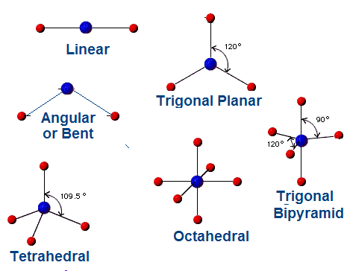
Basic Molecular shapes
The most common shapes of molecules are shown at the right

Slide 20
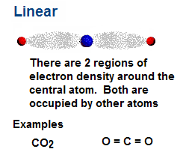
Linear Molecules
Linear molecules have only two regions of electron density.

Slide 21
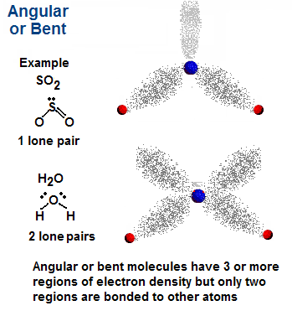
Angular or Bent
Angular or bent molecules have at least 3 regions of electron density, but only two are occupied

Slide 22
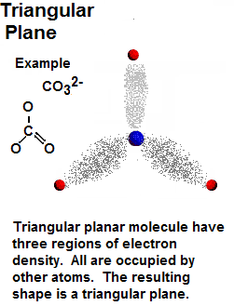
Triangular Plane
Triangular planar molecules have three regions of electron density.
All are occupied by other atoms

Slide 23
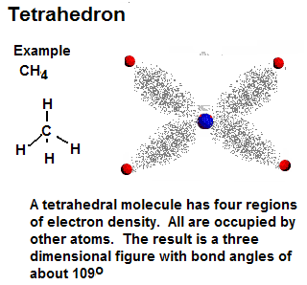
Tetrahedron
Tetrahedral molecules have four regions of electron density.
All are occupied by other atoms

Slide 24
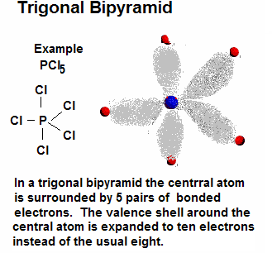
Trigonal Bipyramid
Some molecules have expanded valence shells around the central atom.
In PCl₅ there are five pairs of bonding electrons.
The structure of such molecules with five pairs around one is called trigonal bipyramid.

Slide 25
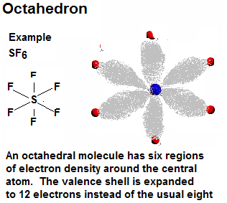
Octahedron
A few molecules have valence shells around the central atom that are expanded to as many as six pairs or twelve electrons.
Sulfur hexafluoride, SF₆ is and example
These shapes are known as octahedrons

Slide 26
Molecular Polarity
Molecular Polarity depends on:
the relative electronegativities of the atoms in the molecule
The shape of the molecule
Molecules that have symmetrical charge distributions are usually non-polar

Slide 27
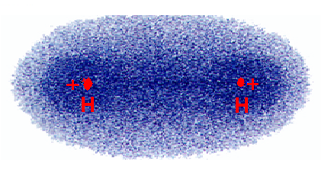
Non-polar Molecules
The electron density plot for H₂.
Two identical atoms do not have an electronegativity difference The charge distribution is symmetrical.
The molecule is non-polar.

Slide 28
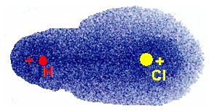
Polar Molecules
The electron density plot for HCl
Chlorine is more electronegative than Hydrogen
The electron cloud is distorted toward Chlorine
The unsymmetrical cloud has a dipole moment
HCl is a polar molecule.

Slide 29
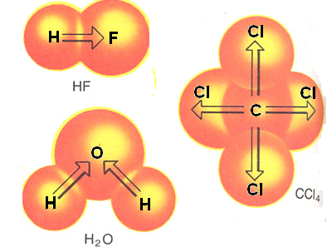
Molecular Polarity
To be polar a molecule must:
Have polar bonds
Have these polar bonds arranged in such a way that their polarity is not cancelled out
When the charge distribution is non-symmetrical, the electrons are pulled to one side of the molecule
The molecule is said to have a dipole moment and therefore polar
HF and H₂O are both polar molecules, but CCl₄ is non-polar

Slide 30
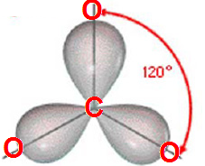
Bond angles
The angle formed between two peripheral atoms and a central atom is known as a bond angle.
.

Slide 31
Bond Angles
Bond angles are determined by the geometry of the electron skeleton. The number of regions of electron density determine the basic bond angle
Skeleton Shape | Electron Regions | Basic Bond Angle
Linear | 2 | 180º
Triangular Plane | 3 | 120º
Tetrahedron | 4 | 109º
Trigonal Bipyramid | 5 | 90º and 120º
Octahedron | 6 | 90º

Slide 32
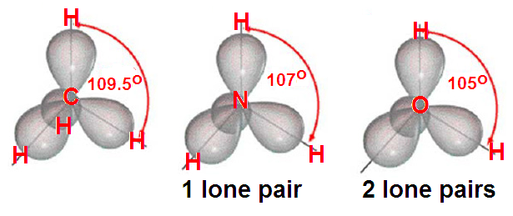
Bond Angles and Lone Pairs
When there are lone pairs present they tend to repel slightly more. Hence the bond angles are slightly smaller.
.
Methane Ammonia Water

